Slide 1
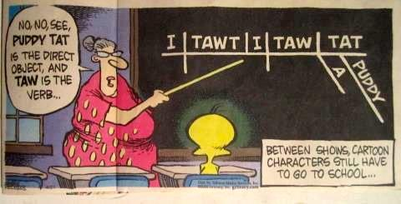
Complex Sentences
Dependent Clauses, Subordinating Conjunctions, and Commas

Slide 2
What we already know...
Simple Sentences:
Contain at least one (1) subject and (1) predicate.
Are independent clauses; they are complete thoughts.
Can be arranged in 4 patterns: SV/SVV/SSV/SSVV

Slide 3
What we already know...
Compound Sentences
Contain two (2) independent clauses
Independent clauses are held together by:
Coordinating Conjunctions (FANBOYS)
Conjunctive Adverbs (Show Relationships)

Slide 4
What we already know...
Compound Sentences
Coordinating Conjunction (c) = comma
Conjunctive Adverb (ca) = semicolon AND comma
Can be made into 3 patterns:
I ; I
I , c I
I ; ca, I

Slide 5
Contain an independent clause and a dependent clause
Can contain a comma
COMPLEX SENTENCES

Slide 6
A complex sentence contains one independent clause and one or more dependent clauses.
COMPLEX SENTENCES

Slide 7
EXAMPLE:
When I get back to school, I’m actually going to appreciate it.
DEPENDENT CLAUSE = RED
INDEPENDENT CLAUSE = BLUE
COMPLEX SENTENCES

Slide 8
EXAMPLE:
I’M ACTUALLY GOING TO APPRECIATE SCHOOL WHEN I GET BACK TO IT.
DEPENDENT CLAUSE = RED
INDEPENDENT CLAUSE = BLUE
COMPLEX SENTENCES

Slide 9
I = Independent Clause
D = Dependent Clause
D, I
Even though it is still winter, I want to play outside.
ID
I want to play outside even though it is still winter.
COMPLEX SENTENCES

Slide 10
SUBORDINATING CONJUNCTION
Is another form of glue
Connects the dependent and independent clause so the dependent clause makes sense.
Shows relationships between two clauses that are not equally important.
When you make something subordinate, you are saying that it has less importance.
TERMS TO KNOW...

Slide 11
AFTER ALTHOUGH AS AS IF AS LONG AS AS SOON AS AS THOUGH BECAUSE BEFORE | EVEN IF EVEN THOUGH IF IN ORDER THAT JUST AS LIKE ONCE PROVIDED RATHER THAN | SINCE SO THAT THAN THOUGH UNLESS UNTIL WHEN WHENEVER WHILE
SUBORDINATING CONJUNCTIONS

Slide 12
Is a complete thought.
Can stand alone.
Is a simple sentence.
INDEPENDENT CLAUSE

Slide 13
Is an complete thought.
Cannot stand alone.
DEPENDENT CLAUSE

Slide 14
When a dependent clause introduced by a subordinating conjunction comes first in a sentence, use a comma.
If a dependent clause introduced by a subordinating conjunction comes after an independent clause in a sentence, do not use a comma.
PUNCTUATION RULES

Slide 15
I = Independent Clause
D = Dependent Clause
D, I
Even though it is still winter, I want to play outside.
ID
I want to play outside even though it is still winter.
COMPLEX SENTENCES

Slide 16
Let’s practice! In your notebook:
1.Write two (2) simple sentences in the SV pattern.
2.Take those two (2) simple sentences, and combine them to create one (1) compound sentence.
3.Now, look at all of the sentences you have written. Write two (2) complex sentences; one for each pattern (D,I and ID).
LET’S PRACTICE...

