Slide 1
Compound Sentences
Commas, coordinating conjunctions, semicolons, and conjunctive adverbs

Slide 2
Review: Simple Sentences
A simple sentence is an independent clause; it can stand alone.
Simple Sentence Patterns: SV/SSV/SVV/SSVV
Simple sentences are the building blocks of all other sentence types.

Slide 3
Compound Sentences: Terms
An independent clause is a simple sentence; it can stand alone. It contains a subject and a verb, and is a complete thought.
A coordinating conjunction connects words, phrases, and clauses.
A conjunctive adverb is an adverb that connects two independent clauses. They show relationships like cause and effect, sequence, contrast, and comparison.

Slide 4
Use a comma between two independent clauses that are joined by a coordinating conjunction.
Coordinating Conjunction = FANBOYS
Example: I ran to the store, but I did not buy anything.
Do NOT use a comma between compound subjects or compound verbs.
Example: I ran to the store and bought milk.
Use a comma after a conjunctive adverb.
Example: I ran to the store; however, I did not buy milk.
COMMA RULES

Slide 5
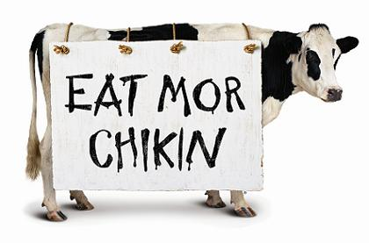
Use a semicolon to join two or more closely related independent clauses that are not connected with a coordinating conjunction (FANBOYS).
Example: I ran to the store; I bought milk.
SEMICOLON RULES

Slide 6
A conjunctive adverb is an adverb that connects two independent clauses. They show relationships like cause and effect, sequence, contrast, and comparison.
Common Conjunctive Adverbs:
SEMICOLON RULES
also | beside | however | instead
meanwhile | then | therefore

Slide 7
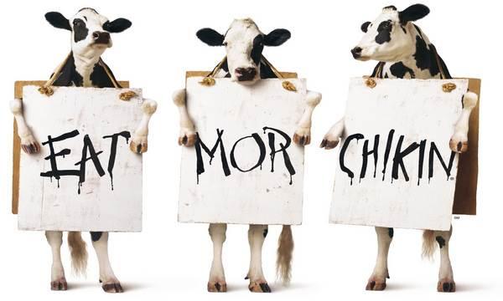
A semicolon is used before a conjunctive adverb when it connects two independent clauses in a compound sentence.
Example: I ran to the store; however, I forgot to buy milk.
SEMICOLON RULES

Slide 8
A compound sentence has more than one part that can stand alone (independent clause).
Independent clauses are connected by coordinating conjunctions, conjunctive adverbs, or a semicolon.
We went to Buffalo Wild Wings, and most of us
ate all night.
COMPOUND SENTENCES

Slide 9
Compound Sentence Patterns:
I = Independent Clause
c = Coordinating Conjunction (FANBOYS)
ca = Conjunctive Adverb
Pattern | Example
I ; I | I went to the store; I bought milk.
I, c I | I went to the store, and I bought milk.
I ; ca, I | I went to the store; however, I didn’t buy milk.
COMPOUND SENTENCES

Slide 10
#2
Compound Sentences

Slide 11
Remember! Compound sentences use:
Compound sentences use commas and/or semicolons.
Coordinating Conjunctions (FANBOYS)
Conjunctive Adverbs

Slide 12
Compound Sentences
Comma
Subject
Verb
We went to Metro City,
Coordinating Conjunction
{
Predicate
and most of us danced all night.
Subject
Verb

Slide 13
Compound Sentences
Hello from Metro City!

Slide 14
Compound Sentences using Coordinating Conjunctions (FANBOYS)
Subject
Predicate,
coordinating conjunction
Subject
Predicate

Slide 15
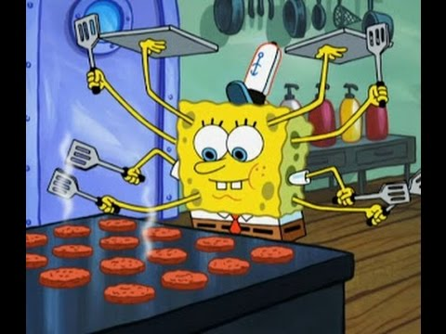
Compound Sentences using Coordinating Conjunctions (FANBOYS)
Spongebob
cooks,
and
Plankton
causes trouble.

Slide 16
!
COORDINATING CONJUNCTIONS
=
FANBOYS
For/And/Nor/But/Or/Yet/So

Slide 17
Compound Sentences
Spongebob cooks
Plankton causes trouble.
Independent Clause #1
Independent Clause #2

Slide 18
Compound Sentences
Spongebob cooks, and Plankton causes trouble.
Remember!
You need to place a comma BEFORE your coordinating conjunction.

Slide 19
Compound Sentences using Conjunctive Adverbs
Subject
Predicate
conjunctive adverb,
Subject
Predicate

Slide 20
!
CONJUNCTIVE ADVERBS
also beside
however instead
meanwhile then
therefore

Slide 21
Compound Sentences
Spongebob is handsome; moreover, he is clever.
Independent Clause #1
Independent Clause #2
Remember! Your semicolon goes before the conjunctive adverb and the comma is placed after it.

Slide 22
Here’s the curveball…
Conjunctive Adverbs Float
Conjunctive adverbs (ca) are sometimes called floating adverbs because they can be positioned at the beginning, in the middle, or at the end of a clause.

Slide 23
Conjunctive Adverbs: Beginning, Middle, and End
Spongebob is handsome; moreover, he is clever.
Spongebob is handsome; he is, moreover, clever.
Spongebob is handsome; he is clever, moreover.

Slide 24
Compound Sentences
Remember! The compound sentence patterns are:
I ; I Patrick went to the store; he bought milk.
I, c I Patrick went to the store, and he bought milk.
I ; ca, I Patrick went to the store; however, he didn’t buy milk.

