Slide 1
Literary Terms
[2018-2019]

Slide 2
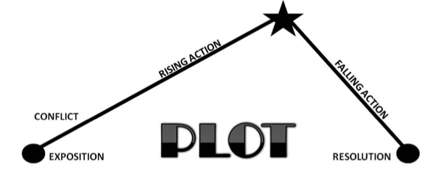
What we already know...
PLOT
A plotline breaks down the elements of a plot, which includes 5 parts:
Exposition
Complications (Rising Action)
Climax
Falling Action
Denouement (Resolution)

Slide 3
What we need to know...
Exposition: Introduces the basic information by “setting the stage”- introduces the characters and conflicts and it foreshadows the conflict.
Complications (Rising Action): arise when the characters takes steps to deal with the conflict(s) introduced in the exposition.

Slide 4
What we need to know...
Climax: the moment of the greatest emotional intensity or suspense; it marks the moment when the conflict MUST be resolved in one way or another.
Falling Action: The events that move the reader from the high point of the climax towards the resolution.
Denouement (Resolution): Final part of a story where the threads of a story are tied together and conflicts are usually resolved, but not always.

Slide 5
What we need to know...
Setting is important because it contributes to many pieces of the story including:
the emotional effect(s)on the reader
the conflict(s)
the characterization
Setting is:
the time and place of a story
in longer stories, there can be multiple settings
Setting includes:
a geographical location
a specific time of day
a time period
the weather

Slide 6
What we need to know...
Conflict: the struggle between opposing forces in a story.
The opposition occurs between the protagonist and another character or force.
All stories have conflict; without it there is no story.
Longer stories have multiple conflict.
Conflict is what keeps the story moving from event to event.
Conflict teaches us about what it means to be human through the actions and reactions of the characters.
External Conflict: the struggle between the character and a force outside of himself.
Character vs. Character
Character vs. Nature
Character vs. Society
Character vs. Fate/Destiny
Internal Conflict: the struggle within a character’s mind.
Character vs. Self

Slide 7
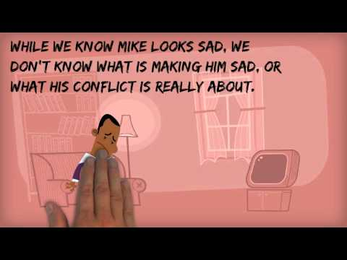
What we need to know...
Let’s take a closer look at conflict. Note this video doesn’t include the external conflict, Character vs. Fate/Destiny

Slide 8
What we need to know...
Character: A person or animal that carries out the action in a story.
A round character is well developed during a story. Woody (Toy Story), Rainsford (MDG),
a flat character is not well-developed during a story.
Examples? Turn-N-Talk
A dynamic character evolves during a story (coming full circle).
A static character does not change during a story.
Examples? Turn-N-Talk

Slide 9
What we need to know...
Indirect Characterization:
the reader must infer what they know about the character by analyzing:
the character’s speech/words, thoughts, & actions
the character’s appearance
what other characters in the story say or think about the character
Example: “The first thing Rainsford’s eyes discerned was the largest man Rainsford had ever seen- a gigantic creature, solidly made and black bearded to the waist.” “ivan is an incredibly strong fellow,” remarked the general, “but he has the misfortune to be deaf and dumb. A simple fellow, but, i’m afraid, like all his race, a bit of a savage.”
Characterization: the techniques used by an author to develop the reader’s understanding of the character(s). Two Types: Direct & Indirect.
Direct Characterization:
the reader is directly told by the narrator or author about the character.
Example: "Rainsford sprang up and moved quickly to the rail." "When he opened his eyes he knew from the position of the sun that it was late in the afternoon." "He examined the ground closely and found what he had hoped to find--the print of hunting boots."
What does the example below say about General Zaroff?
What does the example below say about Raiord?

Slide 10
Theme: the message the author is conveying through the story about a subject. It is Not directly stated; you must infer through analyzation of the story.
What we need to know...
Subject: What the story is about. E.G. Love, Friendship.
The story, “The Three Little Pigs” is about planning ahead.
The Theme is what the author is saying about the subject.
The theme of “The Three Little Pigs” is that those who don’t plan ahead may suffer consequences.
Theme:
Is the unifying or reoccurring idea or motif in a piece of literature.
Usually reveals some kind of truth about human behavior.
Theme: THE Message
It is NOT a summary or a moral or a lesson. It is a statement of what the author is trying to say.

Slide 11
Theme = THE MEssage

Slide 12
Irony:
Verbal- Verbal irony is when a speaker says one thing and really means another. Sarcasm is an example.
Situational- Situational irony occurs when there is a contrast between what would seem appropriate and what really happens or when there is a contrast between what we expect to happen and really does happen.
Dramatic- Dramatic irony occurs when the audience or reader knows something important that a character in a play or story does not know.
What we already know...

Slide 13
Point of View (P.O.V.)
The point of view is the perspective from which the story is told.
What we need to know...
4 Types of P.O.V.:
Omniscient- “All knowing”. The narrator is not a character in the story and knows everything about the story; they act like an observer.
1st Person- Narrator is a character in the story, who tells it from their perspective using the pronoun, “I”.
3rd Person Limited- narrator zooms into the mind of one (1) character and can only see through the eyes of that character. uses “he/she”.
3rd person objective- Narrator is a reporter and only tells what they observe happening in the story.
What we learn about the story (the characters, events, conflicts, etc.) comes from the narrator, who is the person telling the story.

Slide 14
Diction
The author’s word choice, which is intentionally done to create connotation.
Connotation
The emotional meanings attached to words that the reader feels.
Denotation
The literal meaning of the word or the dictionary meaning of a word.
What we need to know...

Slide 15
What we need to know...
Imagery: Language that appeals to the senses.
Collection of pictures or likenesses made with words.
Appeals to the five senses: sight/sound/smell/touch/taste
Descriptions help the reader to form a mental picture of the story.
Figurative Language: the use of language that describes one thing in terms of another but is not meant to be taken literally.
Uses words and goes beyond their ordinary meanings.
They are literary devices that express an author’s meaning and ideas indirectly through descriptions, exaggerations, and comparison.
Imagery paints a picture in the reader’s mind.
Example: As I rounded the corner, a full moon in a black sky watched down upon me. I could only hear the chirp of the crickets echoing in the distance. A warm breeze tickled my nose with the smell of freshly mowed grass.

Slide 16
What we need to know...
Tone: the attitude an author takes toward the text, a character, or the audience in a story.
Tone can be recognized by the language/word choices used by the author.
The language will reveal if the author’s opinion is positive or negative about the subject.
Tone must be inferred through the use of descriptive words.
Tone can use imagery to paint a picture of the author’s opinions.
The tone of a story can be comical (positive), hostile (negative), or impartial (neutral).
Mood: how the reader feels when reading a piece of literature.
A reader can feel optimistic (positive), confused (negative), or indifferent (neutral).

