Slide 1
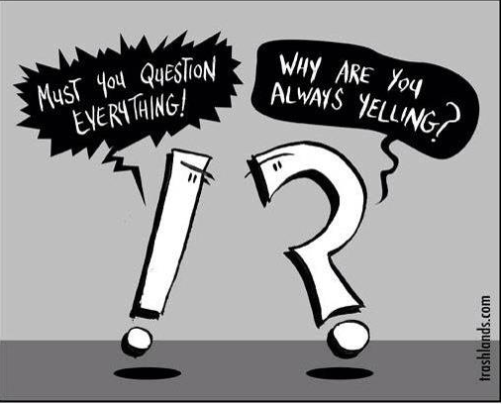
Simple Sentences
End marks and punctuation

Slide 2
END MARKS: THE RULES
End mark: punctuation placed at the end of a sentence.
We use 3 types of end marks:
The Period | .
The question mark | ?
The exclamation point | !

Slide 3
Use a period at the end of a sentence.
I like watching horror movies.
Use an question mark at the end of a question.
Do you like watching horror movies?
Use an exclamation point at the end of an exclamation.
Remember! This type of sentence shows strong emotion.
Yikes! I’m freaking out right now!
Use an exclamation point OR a period at the end of a request or a command.
Stop! This movie is too scary! (Command)
Please pause the movie. (Request)
END MARK RULES

Slide 4
Use a period for most abbreviations including:
Personal Names: J. Marshall
Titles with names: Mr./Mrs./Ms./Dr./Sr./Dr.
Addresses: P.O.Box/St./Ave.
Time: a.m./p.m.
END MARK RULES

Slide 5
#1
Sentences: A Refresher
Basic Info all students should know about sentences

Slide 6
Types of sentences
Simple
Compound
Complex
Compound-Complex

Slide 7
Basic Elements of Every Sentence
Subject
Predicate
Subject:
Who are what the sentence is about.
Predicate:
What the subject is doing (contains the verb).

Slide 8
Basic Elements of Every Sentence
Subject
Predicate
Blossom
plays guitar.

Slide 9
Simple Sentences
A simple sentence has one subject and one predicate.
Simple sentences are independent clauses. They express a complete thought.
Subject = Who or what the sentence is about
Verb = What the subject is doing

Slide 10
Simple Sentences
Simple Sentence Patterns:
SV
SVV
SSV
SSVV
A simple sentence can be formed in four (4) ways.

Slide 11
Simple Sentences
Simple Sentence Patterns:
SV
SVV
SSV
SSVV
A simple sentence can be formed in four (4) ways.

Slide 12
Simple Sentences
Subject
Predicate
Blossom
plays guitar.
one subject
one predicate

Slide 13
Simple Sentences
Blossom and Bubbles
fight crime.
compound subject
one predicate

Slide 14
Simple Sentences
Blossom and Bubbles
fight crime and fly.
compound subject
compound predicate

Slide 15
SIMPLE SENTENCE
with compound subject
Blossom and Bubbles fight crime.

Slide 16
SIMPLE SENTENCE
with compound subject and compound predicate
Blossom and Bubbles fight crime and fly.

